Slide 1
Full Stack Project Project Title: PTU Resource Hub
Batch-05
Cegil
Gokulnath P
Hemachandran P

Slide 2
PROBLEM STATEMENT
Student nowadays find it difficult to access the resources available for every topic in the syllabus
Collective information is what is preferred by every student
Hub to share information is lacking in a college environment
The correctness of every information shared is important with respect to sharing these contents
A single person cannot collect all quality resources for a particular topic
With all said, time to gather these resources is the key factor for this problem

Slide 3
OBJECTIVE
To provide all resources related to each topic in an organized manner
To Enable 2-step verification of content and ensuring resource correctness
To provide a Request Forum to ask for new materials and report in case of any discrepancies
To enable admin to manage the request and maintenance part
To provide students functionality of bookmarking the resources to keep track of their progress

Slide 4
TECHNOLOGY STACK
Frontend | Reactjs
Backend | Spring Boot
Database | MySQL
ORM Mapping | JPA(Hibernate)
Testing | Junit, Mockito
Code Coverage | Eclemma
Service Container | Docker
Static Code Analysis | PDM
Collaboration | GitHub

Slide 5
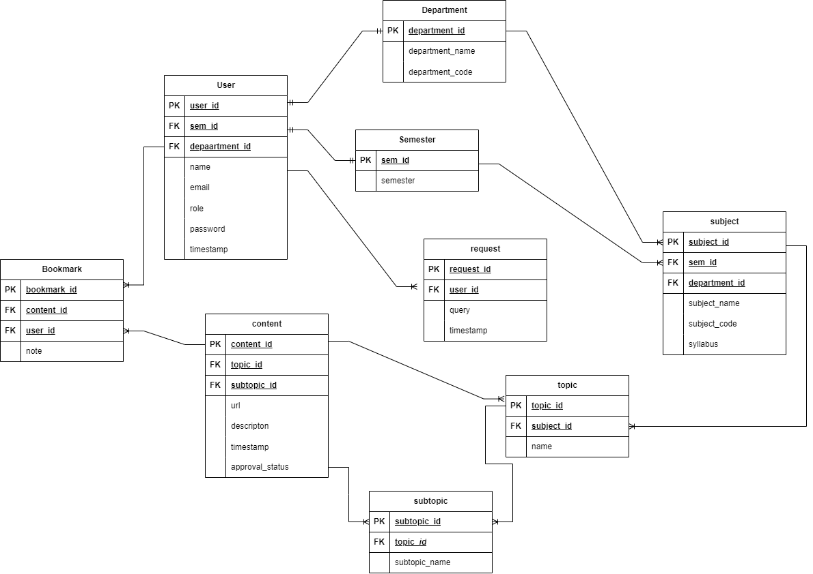
ENTITY-RELATION DIAGRAM

Slide 6
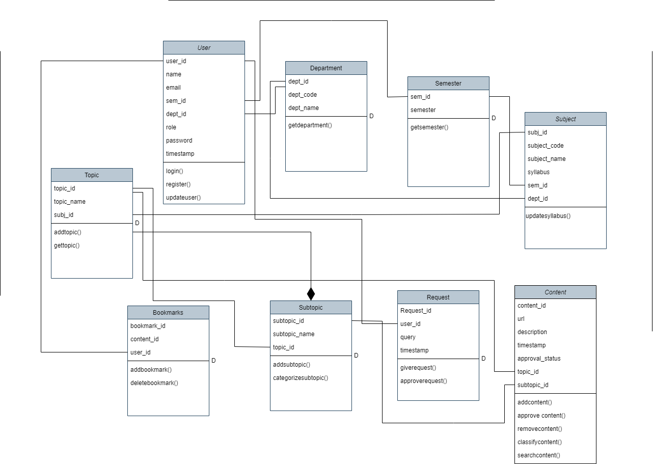
CLASS DIAGRAM

Slide 7
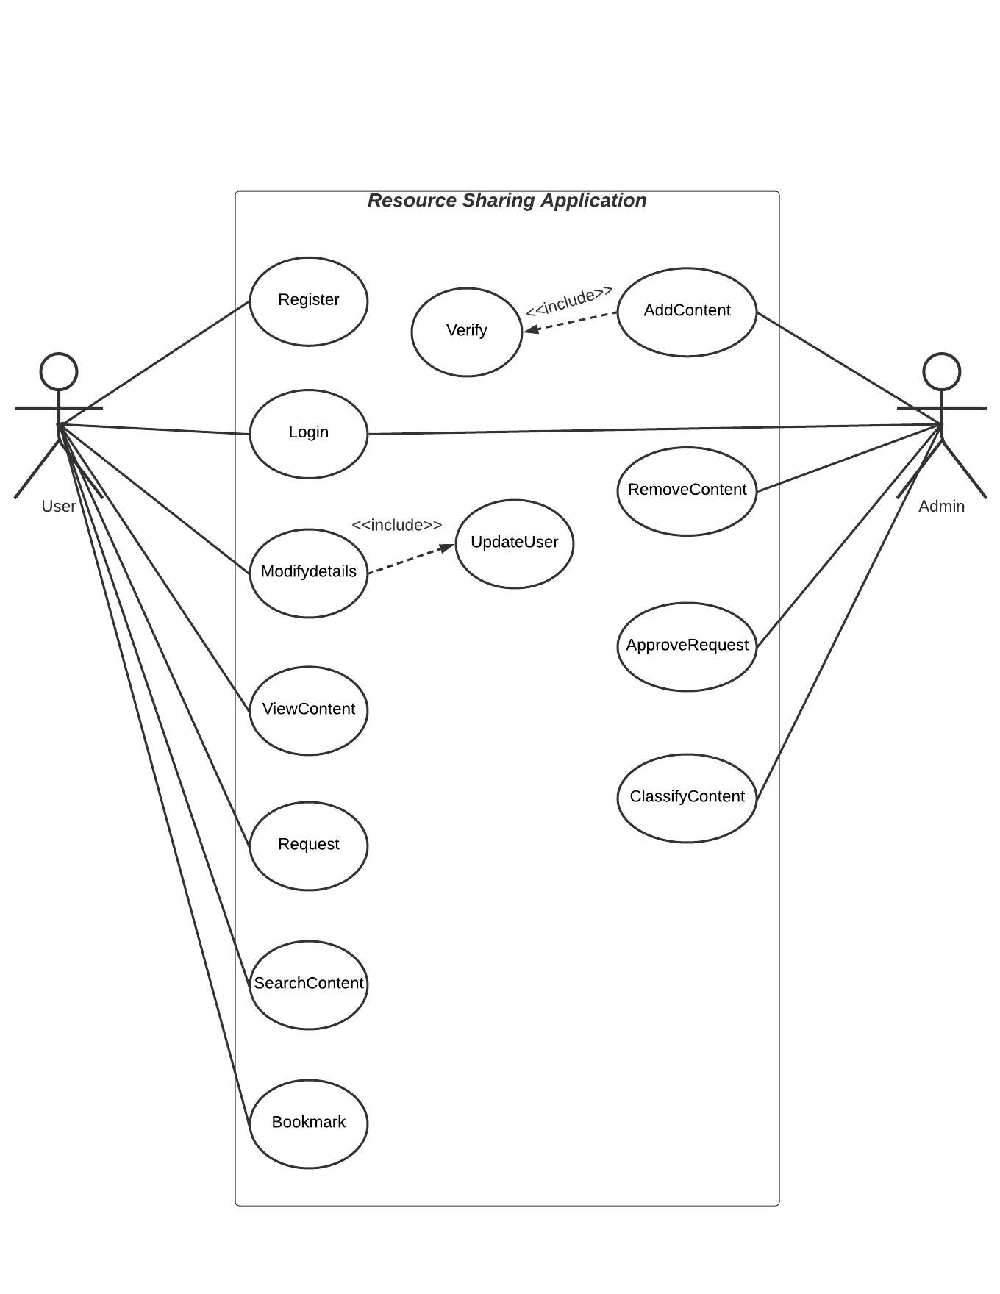
USE-CASE DIAGRAM

Slide 8
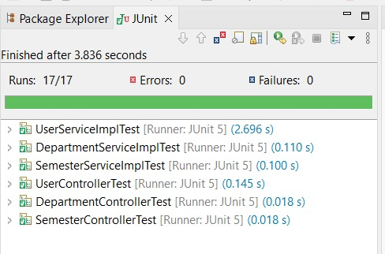
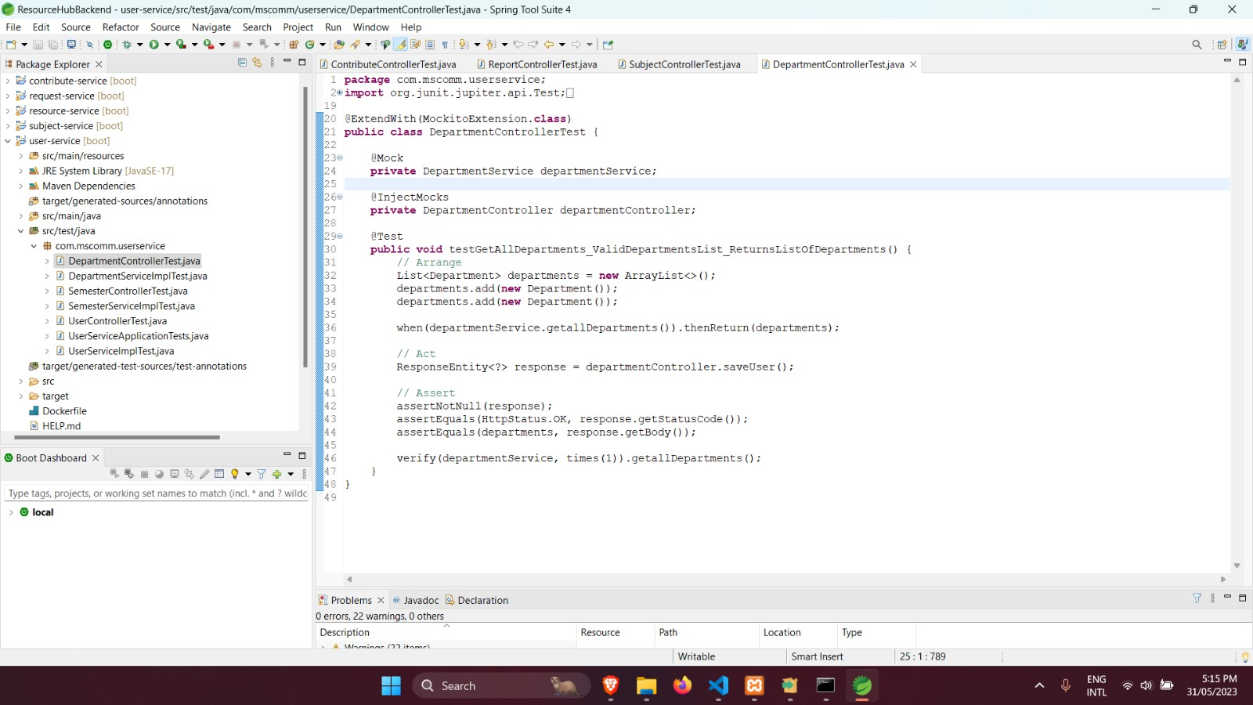
TEST CASES
User Service

Slide 9
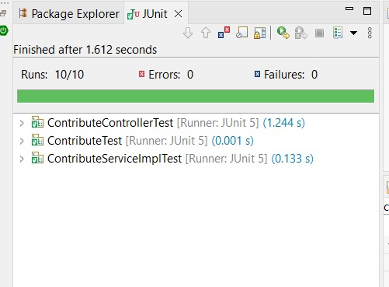
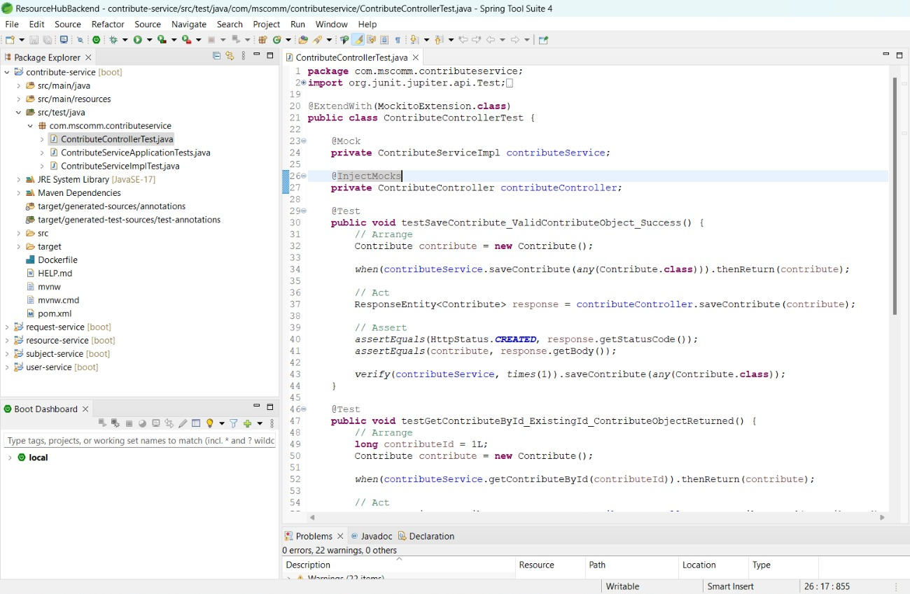
TEST CASES
Contribute Service

Slide 10
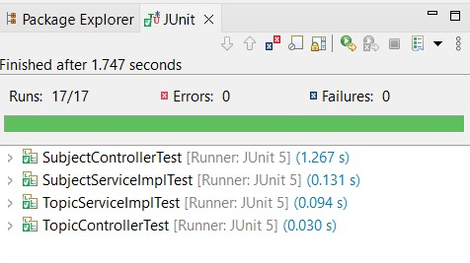
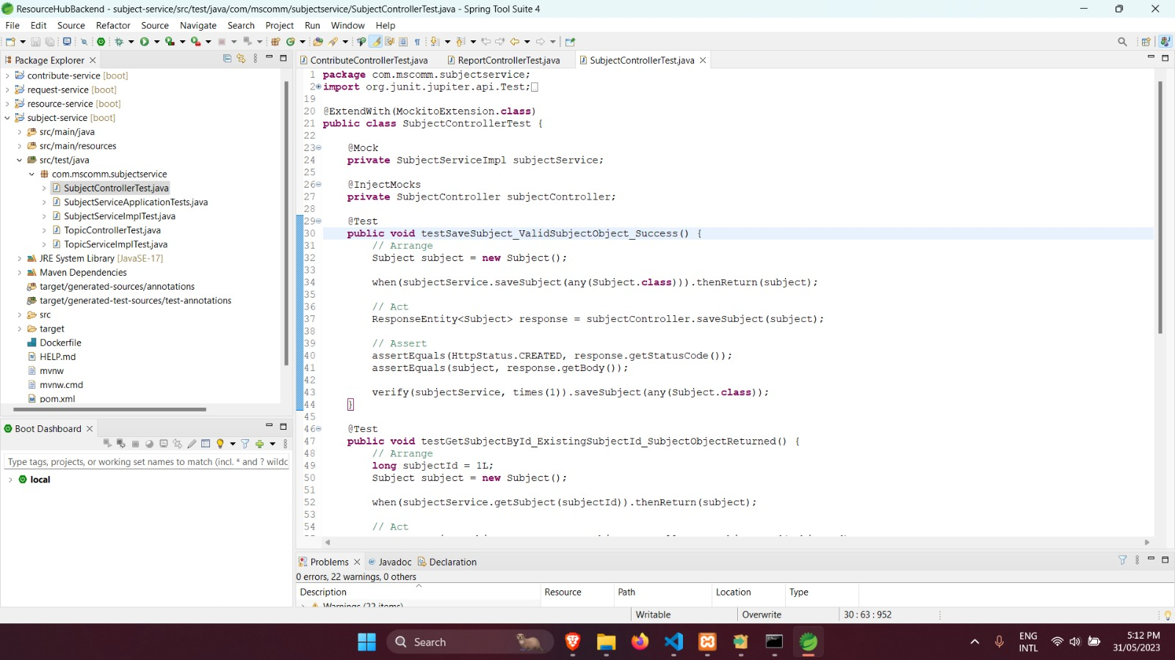
TEST CASES
Subject Service

Slide 11
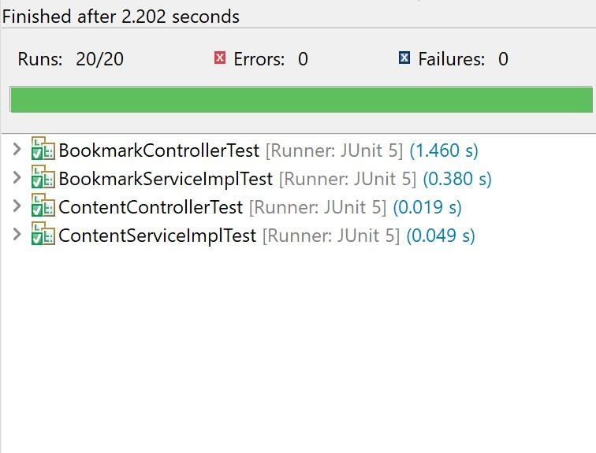
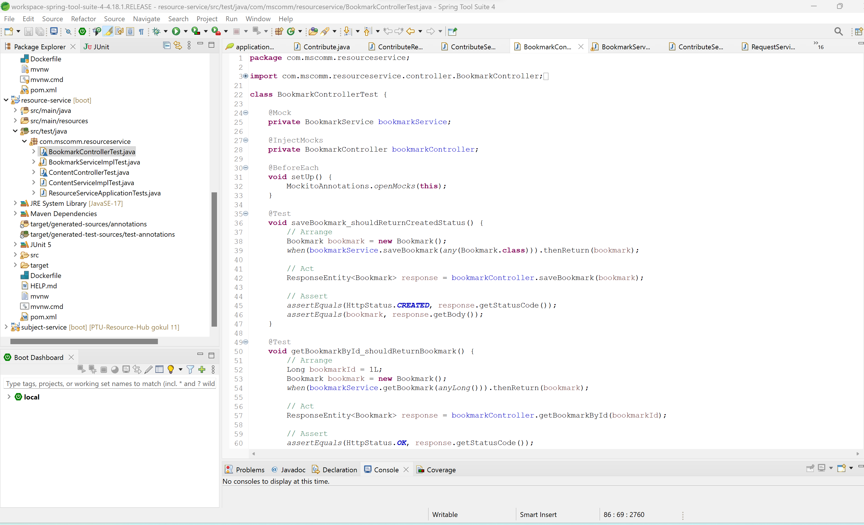
TEST CASES
Resource Service

Slide 12
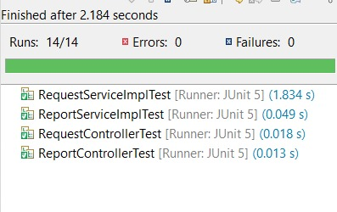
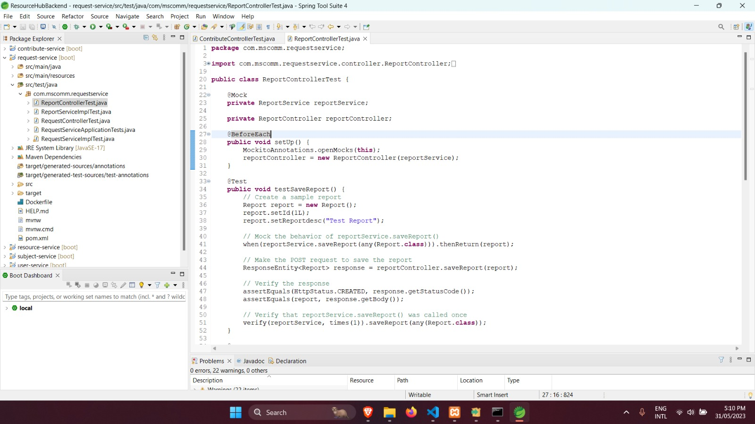
TEST CASES
Request Service

Slide 13
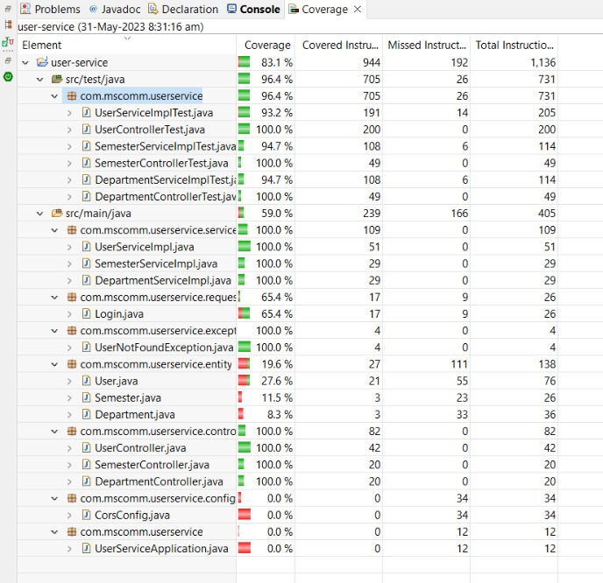
CODE COVERAGE
User Service

Slide 14
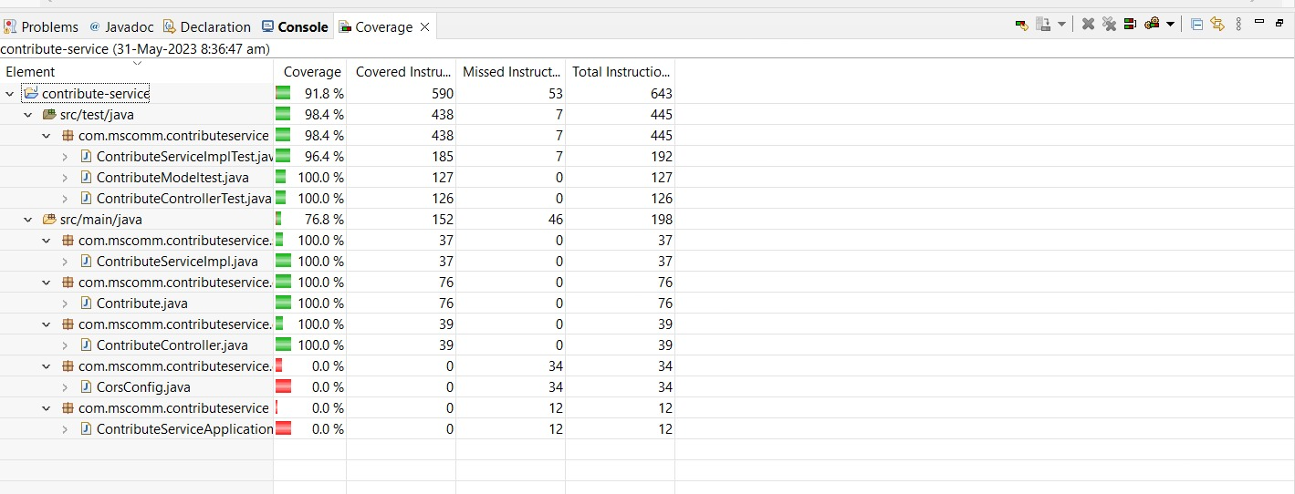
CODE COVERAGE
Contribute Service

Slide 15
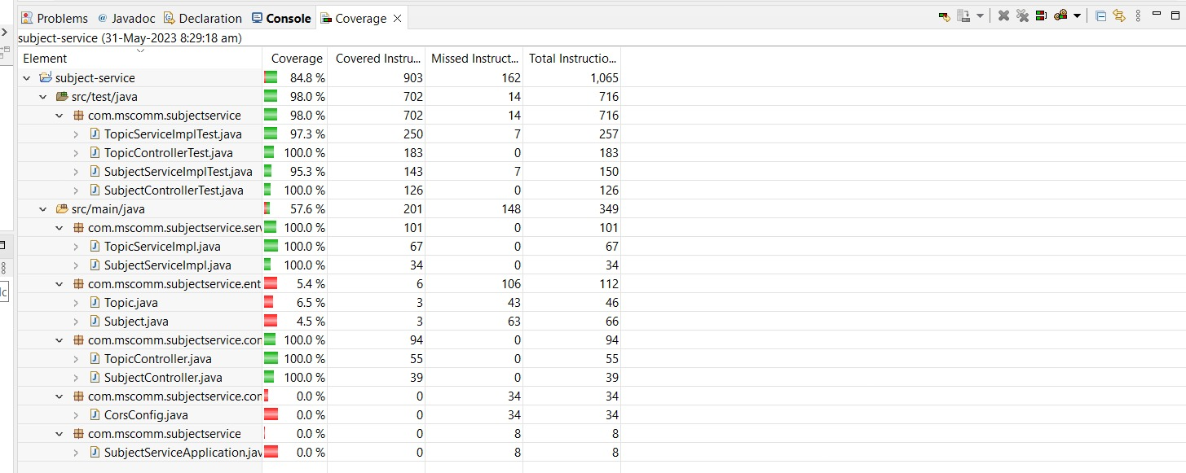
CODE COVERAGE
Subject Service

Slide 16
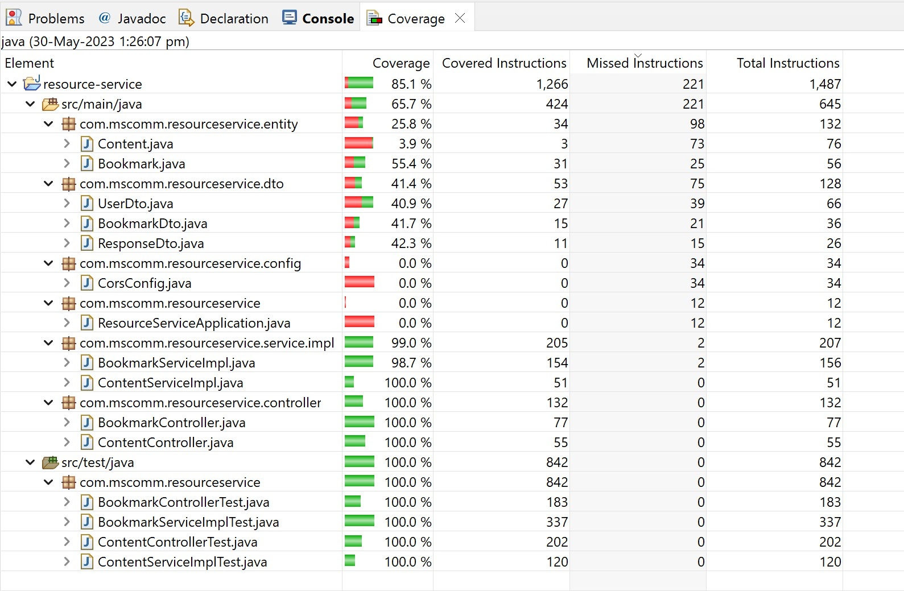
CODE COVERAGE
Resource Service

Slide 17
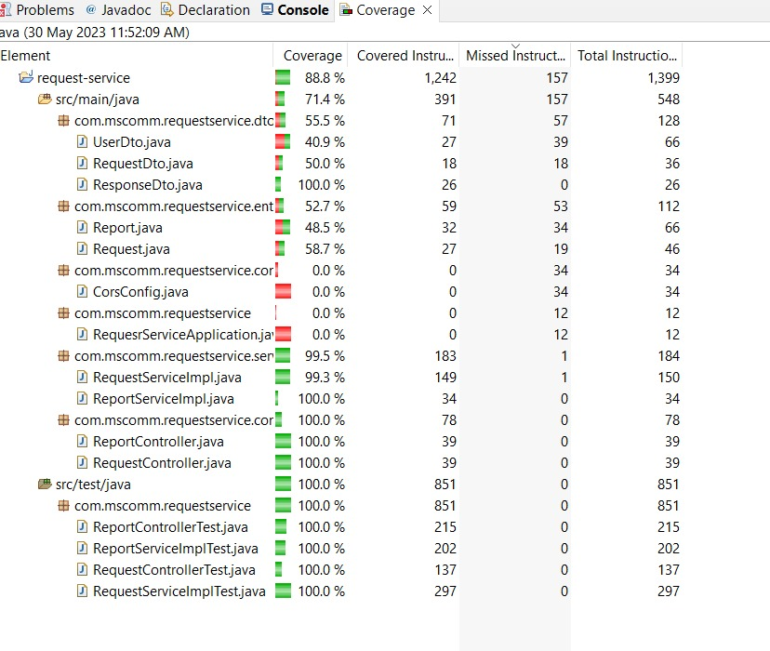
CODE COVERAGE
Request Service

Slide 18
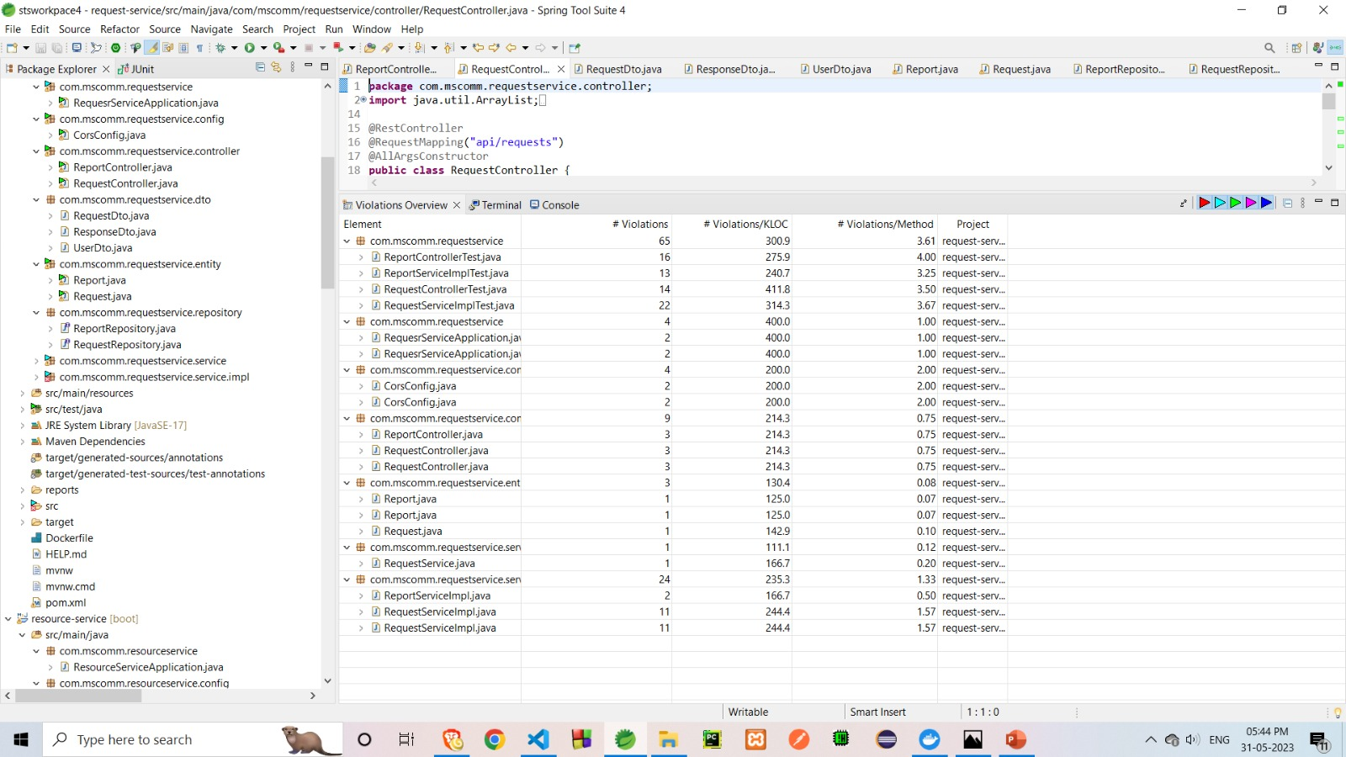
STATIC CODE ANALYSIS

Slide 19
FUTURE IMPLEMENTATIONS
Dynamic search through all the contents of the website.
Splitting topics into byte sized sub-topics.
Providing self-content through a separate blog page.
Separate Profile Dashboard for all students.

Slide 20
CONCLUSION
Resource hub Platform has been created to explore subjects , topics and provide various types of contents for those topics present in a college and also user’s can share resources ,request their demands and report in case of any discrepancies.
Services has been implemented using springboot , made into containers using docker and integrated into react using axios framework.
Testing has been carried out using Junit5 and Mockito.
Code Coverage has been done using Eclemma and PDM has been used for Static Code Analysis.

Slide 21
THANK YOU

